Slide 1

TravelSage: An AI-based system for tourists
Inhouse Project
Group No : 4
Team Members :
Vaishnavi Chavan (D12B-10)
Shreya Nalawade (D12B-36)
Gayatri Vaidya (D12B-63)
Project Mentor :Dr.(Mrs.) Gresha Bhatia
Group Number :
Group Members :

Slide 2
Content
Introduction to Project
Lacuna in the existing systems
Problem Definition
Methodology employed
Hardware, Software, tools and the constraints
Block Diagram
Use Case Diagram
Next Work Plan
Conclusion
References

Slide 3
Introduction
TRAVELING- IT LEAVES YOU SPEECHLESS, THEN TURNS YOU INTO A STORYTELLER !!
Many tour booking and recommendation websites are available.
TravelSage: An AI based tourism system that will be designed aiming the foreigners as well.
Help in designing itineraries and planning a tour.

Slide 4
Lacuna in the existing system
Limited Personalization: Struggle to provide truly personalized Recommendations.
Real-Time Data: Existing systems may not always have access to real-time data, leading to outdated recommendations.
Data Quality and Availability: Tourism-related data may be incomplete, outdated, or not easily accessible.
Lack of accessibility or understanding for tourists: Often the tourists travelling first time in India have a lack of knowledge about the places.

Slide 5
Problem Definition
The project aims at designing a tourism website which will help the user in planning the tour using Artificial Intelligence.
Features like chatbot based recommendations system, itinerary planning, hotel and flight bookings are provided.
Aim to ease the travel planning process by reducing the time required for the same

Slide 6
Literature Survey
Sr No. | Paper Title | Abstract | Lacunas(if any) or future scope | Software /tools used
1. | Smart Tourism System Based on Artificial Intelligence Authors:School of Management, China IEEE 2020 | An AI application that provides an insight about tourism attractions in China. | Only a gives a brief introduction on the topic. | Deep Learning
2. | Tourism Proposal System Using AI IEEE 2021 | An AI application giving information about Kanazawa city | Limited only to one city. | Google Map Api,Ml libraries
3. | Phalkey, M., Rahate, Y., Warathe, Y., Pradhan, S., Bharadwaj, A., & Shinde, A. (2020). Optimized Travel Planner. | The Android Application analyses people’s opinions and gives them the suggestions based on it with the help of Google API | Does not provide itinerary generation | Android studio, Google Maps API

Slide 7
Literature Survey
Sr No. | Paper Title | Abstract | Lacunas(if any) or future scope | Software /tools used
4 | Saluja, Gurucharan Singh, et al. "AI based intelligent travel chatbot for content oriented user queries." International Journal of Applied Science and Engineering 18.2 (2021): 1-8. | The paper suggests about a chatbot that accepts inputs and suggests best possible routes , secure hotel stays | - | Deep Learning,Long Short Term Memory (LSTM) method
5 | Wong, IpKin Anthony, Qi Lilith Lian, and Danni Sun. "Autonomous travel decision-making: An early glimpse into ChatGPT and generative AI." Journal of Hospitality and Tourism Management 56 (2023): 253-263. | Its a case study based paper which dives deep into the possibility of using LLM | - | Langchain LLMs, Openai api
6 | AI and Tourism: Identifying Key Challenges for Research and Practice Iis Tussyadiah and Zheng Xiang Published In: Journal of Travel Research, 2019 | Paper identifies key challenges and research directions for AI applications in tourism and discusses how AI can transform the industry. | - | Case study only

Slide 8
Literature Survey
Sr No. | Paper Title | Abstract | Lacunas(if any) or future scope | Softwares /tools used
7 | Travel Application with Chatbot Service Author: Ramkrishna Vadali,, Shraddha Gaware, Shreya Inamdar (IEEE 2021) | An android app based travel system with a retrieval based chatbot. | Only available for android users. | Python , Deep Learning model
8 | Pandya, Keivalya, and Mehfuza Holia. "Automating Customer Service using LangChain: Building custom open-source GPT Chatbot for organizations." arXiv preprint arXiv:2310.05421 (2023). | The paper explores the obsolescence of traditional customer support techniques, particularly Frequently Asked Questions (FAQs), and proposes a paradigm shift towards responsive, context-aware, and personalized customer interactions. Explains the usecases of Langchaiin | - | Langchain

Slide 9
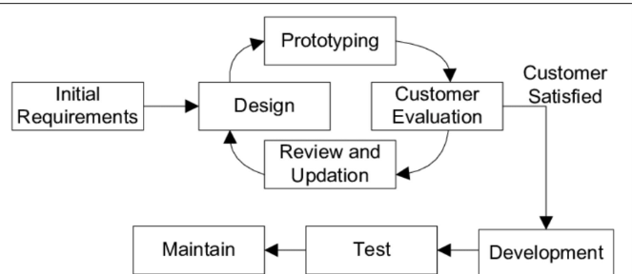
Methodology Employed
TravelSage - An AI Tourism Website is based on Prototype Methodology.
Project Initiation
Market Research and Requirements Gathering
Quick design
Modelling
Construction
Deployment
Monitoring and Maintenance

Slide 10
Hardware Tools and the other tools
Hardware tools
CPU: A CPU with minimum of i5 configuration and higher.
RAM: Preferred RAM 8GB and above.
Tools
IDE : Visual Studio Code and Pycharm
Anaconda Distribution (V23. 5.0)

Slide 11
Software tools
Python: Used python for developing the itinerary generator and hotel booking features
Frontend Technologies: Use HTML, CSS, and JavaScript for building the front-end.
Open AI Assistants: Used for itinerary generation
Firebase : Used for backend
Software Tools

Slide 12
APIs and python libraries
OpenAI API: To obtain real time data
GPT 3.5 Model- Integrated with OpenAi Assistant framework inorder to prepare itinerary
Map Box ,Google maps Api: Used for displaying maps
Streamlit library: Used to display the output of the model
Booking.com API: Used for hotel and flight booking

Slide 13
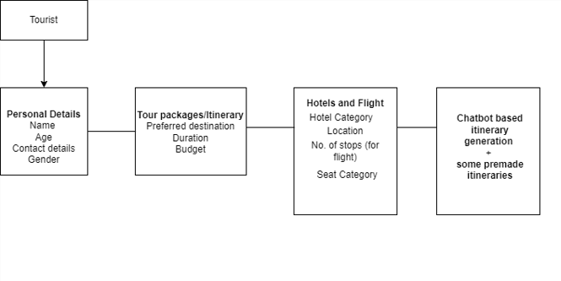
Block Diagram
Inputs

Slide 14
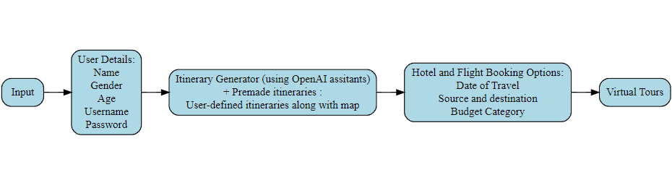
Block Diagram

Slide 15
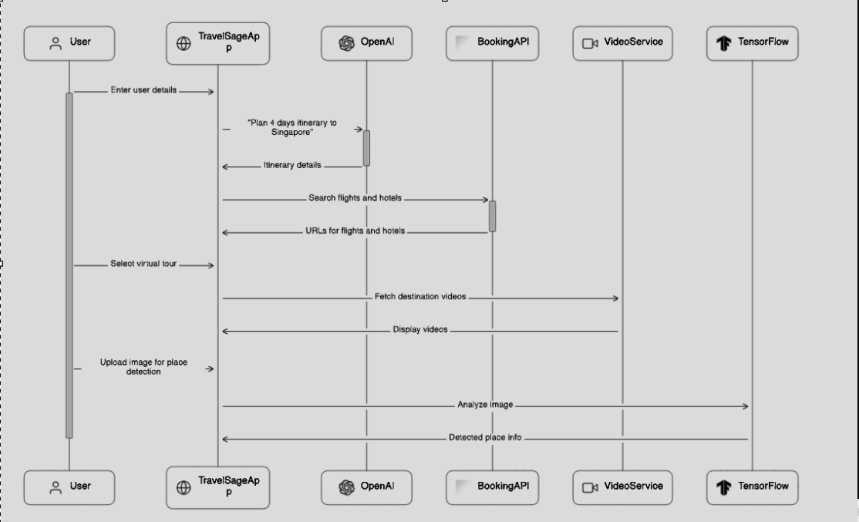
Sequence Diagram

Slide 16
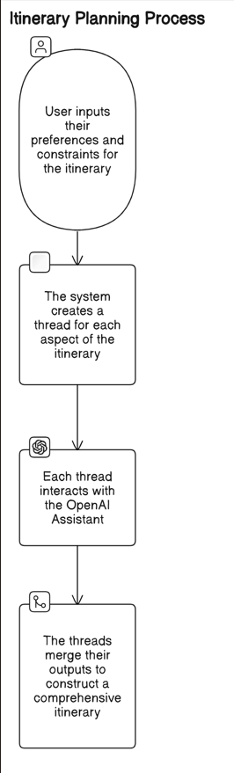
Itinerary Generation Process

Slide 17
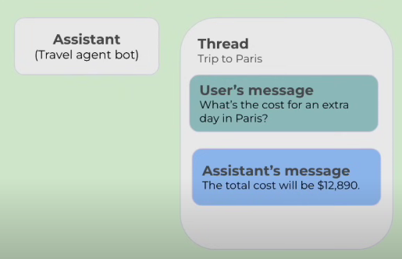
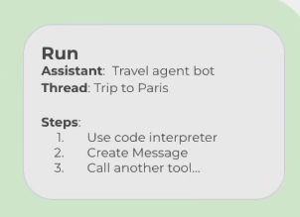
How does OpenAI Assistants work?

Slide 18
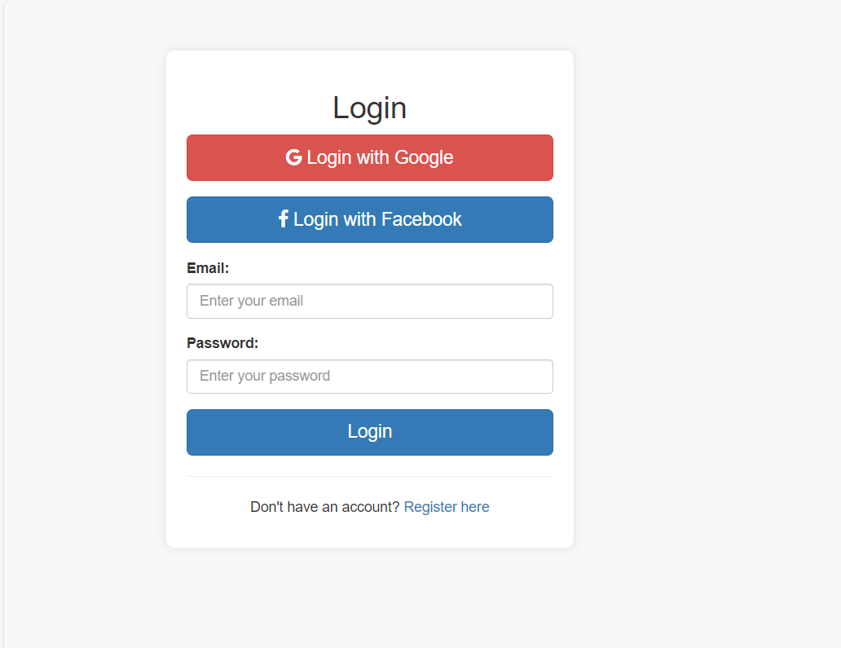
Login Page
Implementation

Slide 19
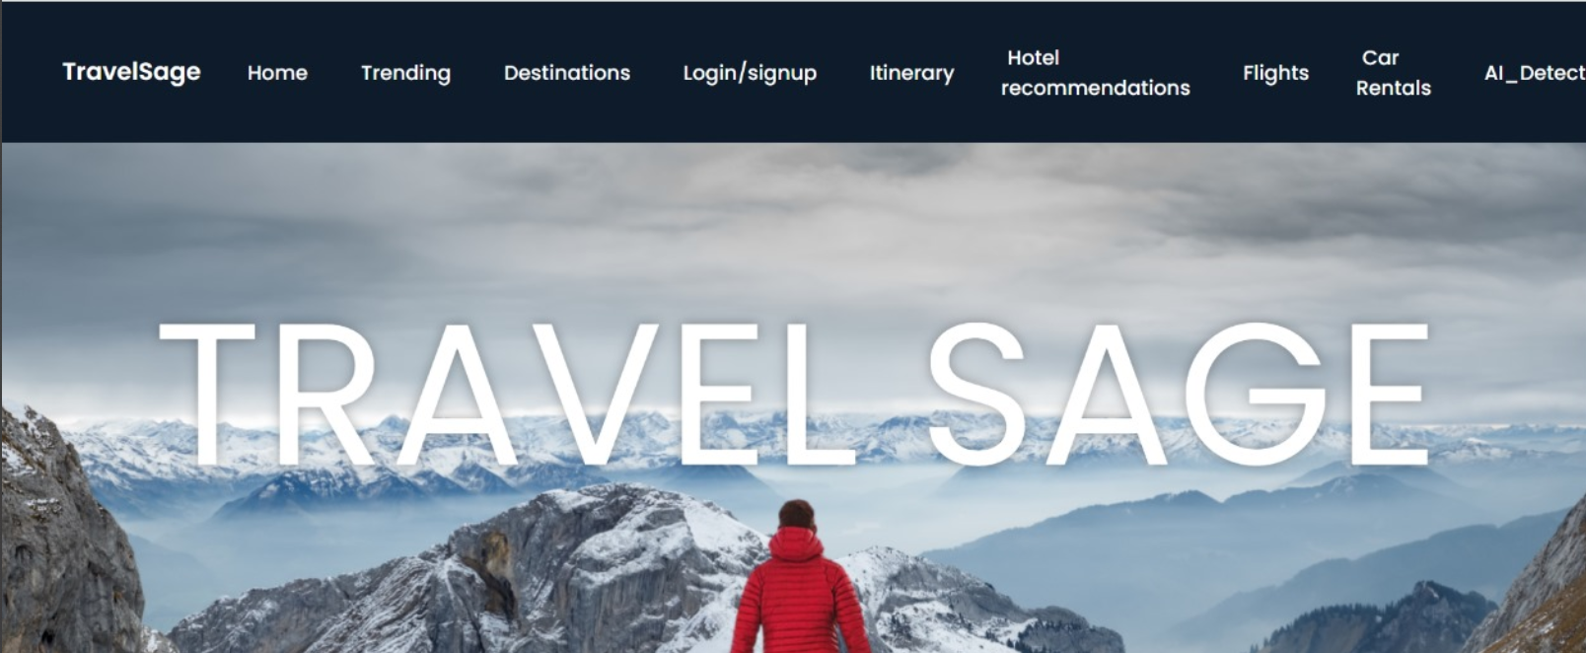
2. Home page

Slide 20
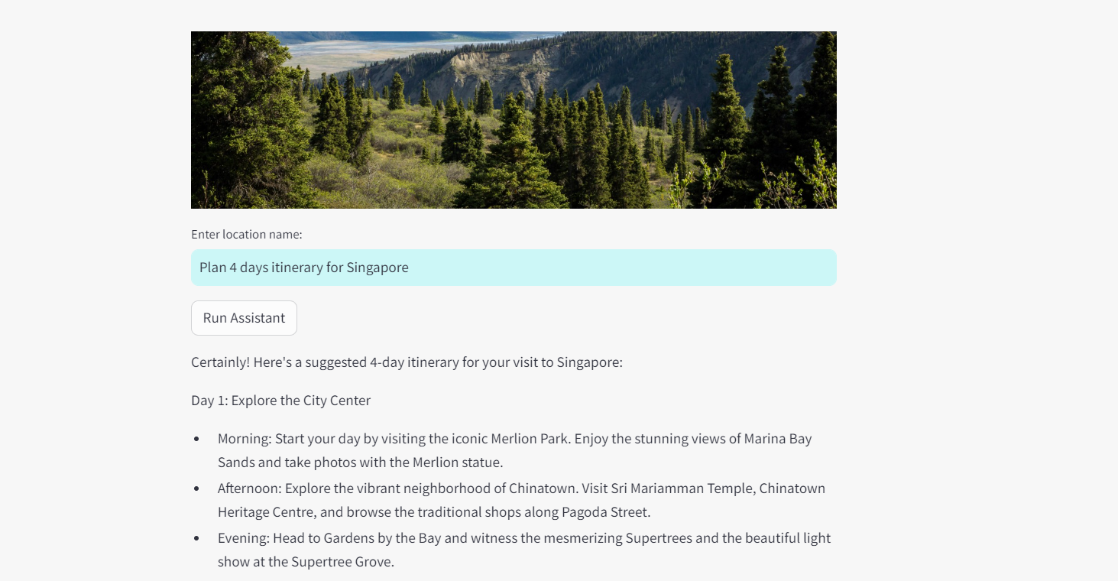
3. Itinerary Generator

Slide 21
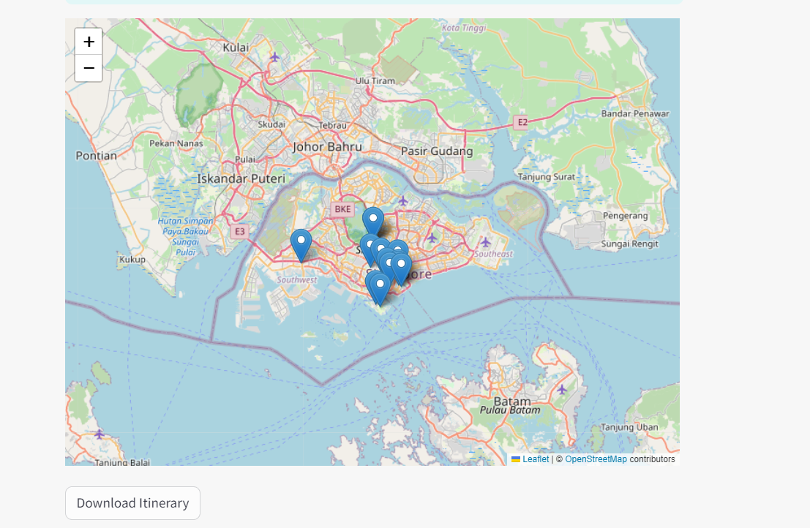
4.Itinerary Generator-Map

Slide 22
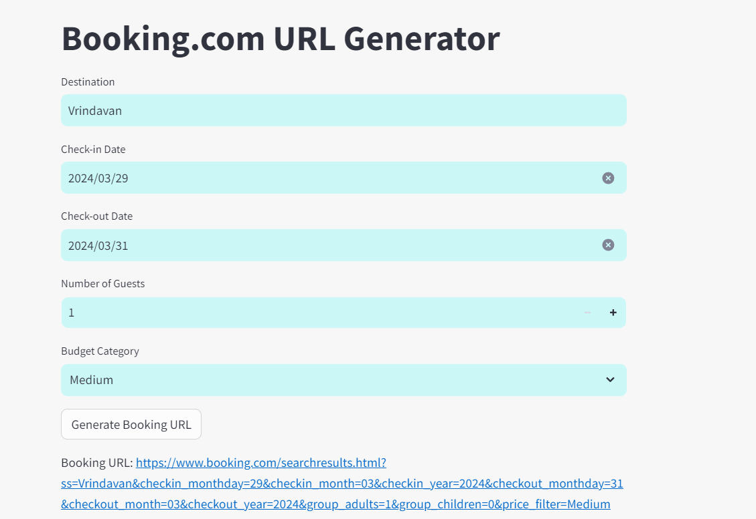
5.Hotel Booking

Slide 23
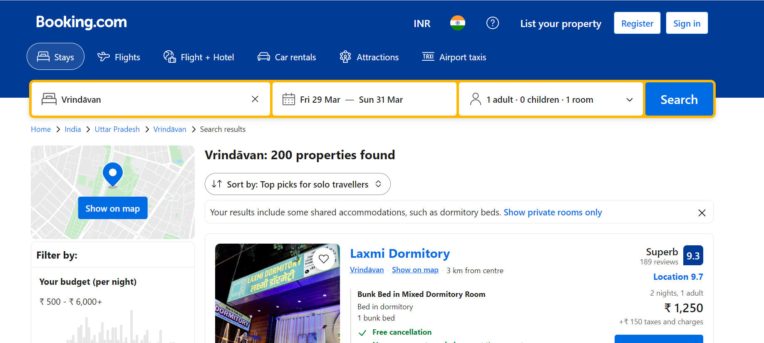

Slide 24
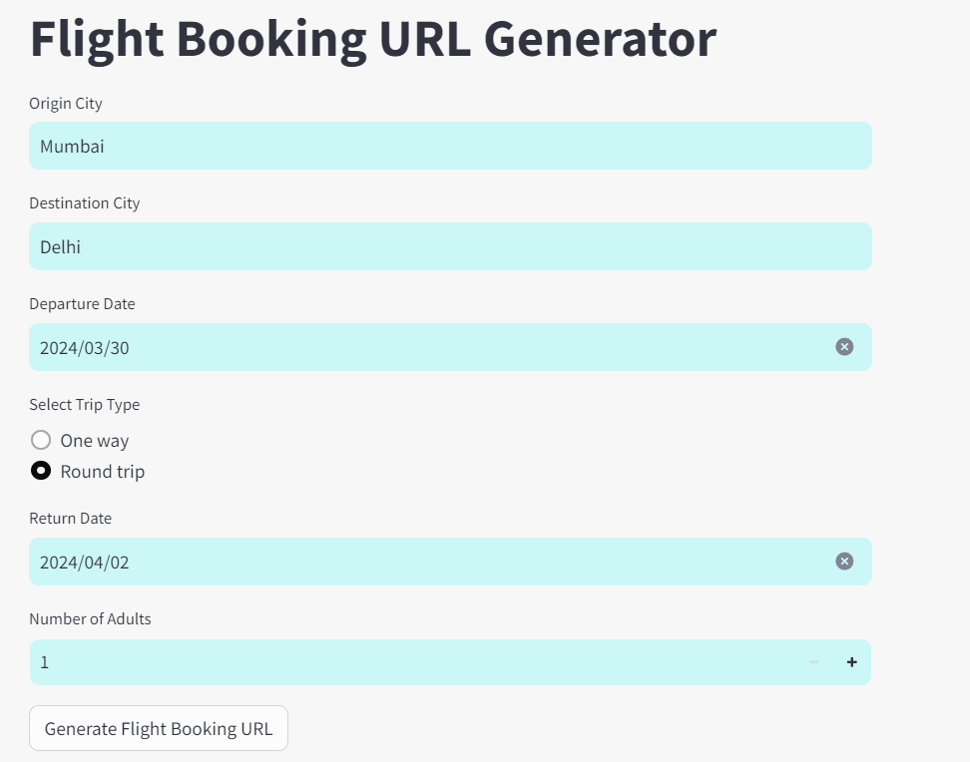
6. Flight Booking

Slide 25
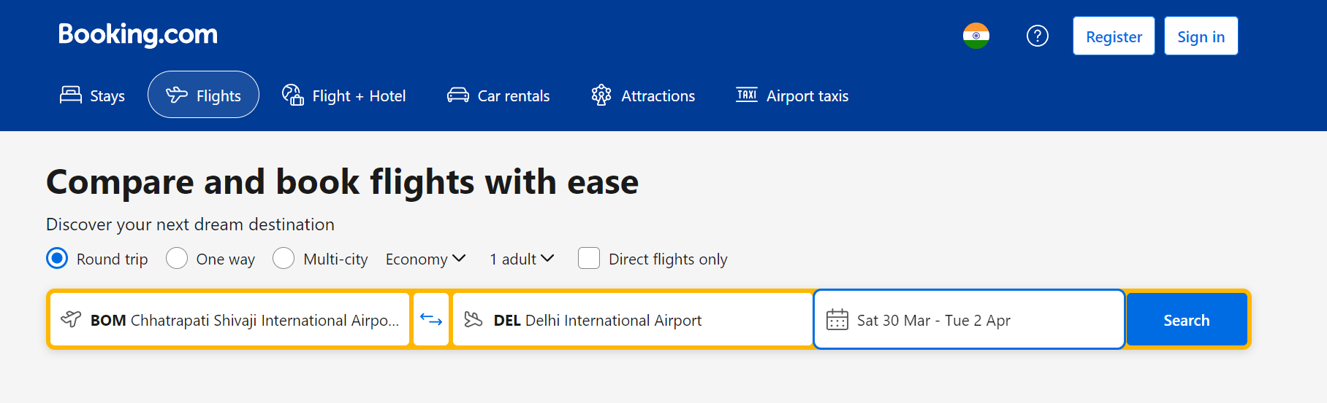
Flight Booking

Slide 26
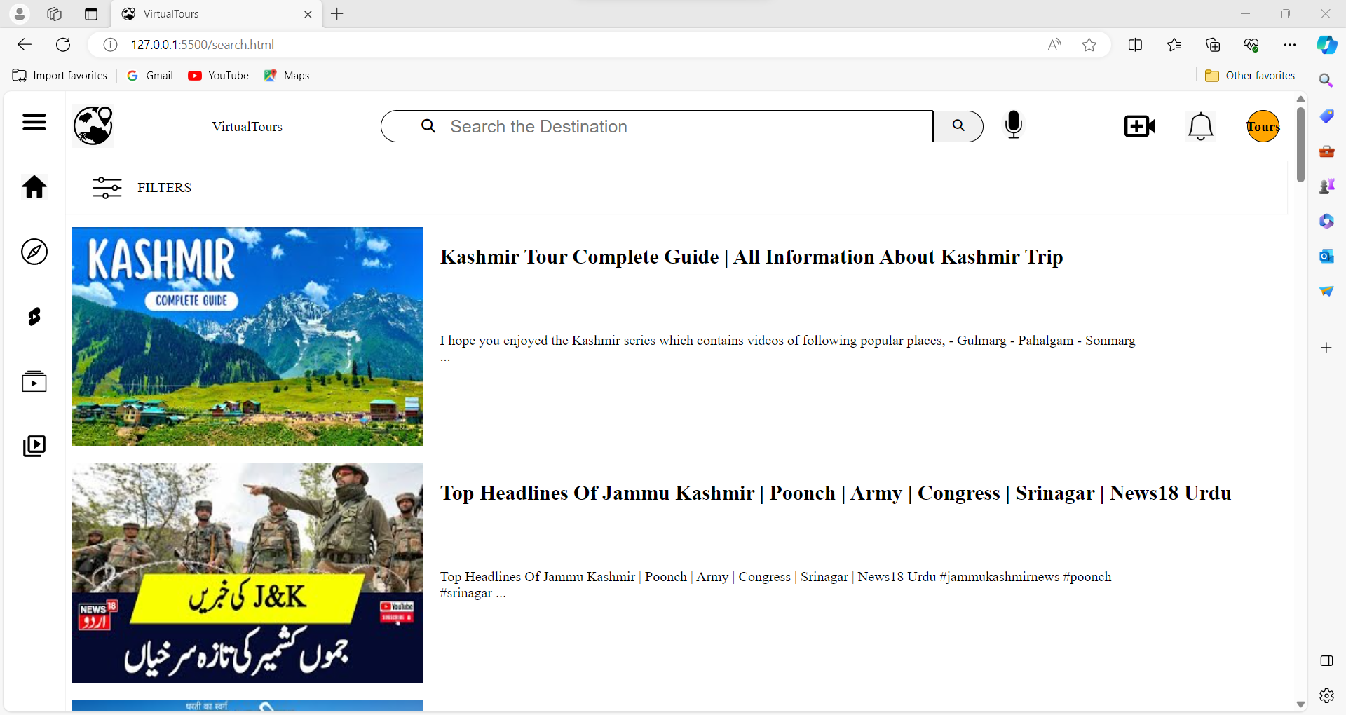
7. Virtual Tour

Slide 27
Future plans
Multi-language support
Personal development
Augmented Reality (AR) Integration
Social media integration

Slide 28
Conclusion
Through the implementation of AI and machine learning models, this project can provide travelers with personalized recommendations, virtual tour, streamline itinerary planning and accommodations for efficiency.

Slide 29
References
[1]. M. Xu, "Research on Smart Tourism System Based on Artificial Intelligence," 2023 IEEE 3rd International Conference on Information Technology, Big Data and Artificial Intelligence (ICIBA), Chongqing, China, 2023, pp. 201-205, doi: 10.1109/ICIBA56860.2023.10165293.
[2] Bonn M.A & Fur H.L (1998)”Using internet as a pleasure planning tool: An examination of socio demographic and behavioral characteristics among internet users and non users”’ Journal of Hospitality and tourism research, Vol 22 No:3,pp 303-317.
[3]. Chrysovelidis, Georgios. "Designing a chatbot for tourism." (2020). (pp. 110-116)
[4]Nica, I., Tazl, O. A., & Wotawa, F. (2018, September). Chatbot-based Tourist Recommendations Using Model-based Reasoning. In ConfWS (pp. 25-30).

Slide 30
References
[5] Gurucharan Singh Saluja ,N. Maheswari,M. Sivagami,”AI based intelligent travel chatbot for content oriented user queries”
International Journal of Applied Science and Engineering (2021)
[6] Ashay Argal, Siddharth Gupta, Chang Choo, “Intelligent travel chatbot for predictive recommendation in echo platform”
2018 IEEE 8th Annual Computing and Communication Workshop and Conference, CCWC 2018 (2018)
[7] Wilkerson, Chad (2003). "Travel and Tourism: An Overlooked Industry in the U.S. and Tenth District" (PDF). Economic Review. 88 (Third Quarter): 45–72. ISSN 0161-2387. OCLC 295437935. Archived from the original (PDF) on 9 January 2011. Retrieved 31 October 2007.
[8] Bulchand-Gidumal, Jacques. (2020). Impact of Artificial Intelligence in Travel, Tourism, and Hospitality. 10.1007/978-3-030-05324-6_110-1.
[9] Ukpabi, Dandison & Aslam, Bilal & Karjaluoto, Heikki. (2019). Chatbot Adoption in Tourism Services: A Conceptual Exploration. 10.1108/978-1-78756-687-320191006.
[10] Chavali, Kavita & Sahu, Subrat. (2008). Comparative Study of Tourism Websites in India - With special reference to South India.

